Slide 1
Keylogger 2 Lab

Slide 2
Keylogger 2 Lab
Materials needed
Kali Linux Virtual Machine
Windows 7 Virtual Machine
Software Tools used (both from Kali Linux OS)
Metasploit Framework
Pre-requisites:
Keylogger 1 Lab

Slide 3
Pre-requisites
Be sure you have explored and understand the following lab.
This lab makes use of:
Backdoor Trojan 1 Lab
You need a meterpreter reverse_http session

Slide 4
Objectives Covered
Security+ Objectives (SY0-501)
Objective 1.1 – Given a scenario, analyze indicators of compromise and determine the type of malware
Backdoor Trojan 1
DHS CAE Units
CTH – Describe different types of attacks and their characteristics

Slide 5
What is a Keylogger Attack?
Recording all the keys being pressed on a keyboard
An example, a keylogger captures the following keys pressed:
www.chase.com<ENTER>jdimon56<TAB>@pp13s33d<ENTER>
What bank does this person use? What are their login credentials?
Notes:
Bank: Chase
Username: jsmith17 Password: @pp13s33d

Slide 6
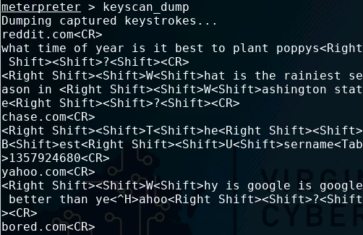
The Keylogger 2 Lab
Open Meterpreter Session
List the Processes
Migrate Process
Start the Keylogger
Play the Victim
View Logged Keystrokes
Decipher Keystrokes
Your Turn

Slide 7

Open a Meterpreter Session
MUST HAVE!!!
Open a Meterpreter Session to Windows
You must have access to an exploited Windows machine
Must have a reverse http session open in the meterpreter
Use the Backdoor/Trojan 1 Lab to open a meterpreter session

Slide 8
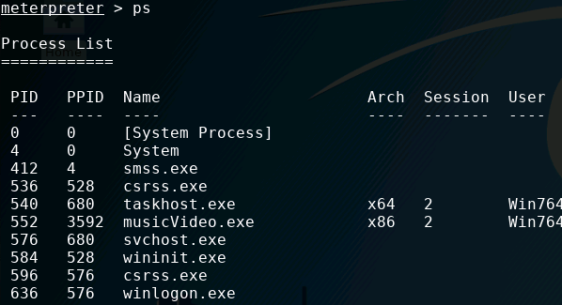
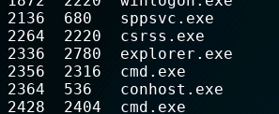
List the Processes
List all the processes available
ps
Find the explorer.exe
Write down it’s PID (PID = process ID)
explorer.exe’s PID

Slide 9


Migrate Process
Navigate to the explorer
migrate explorer.exe-PID
You should receive a “Migration completed successfully” notification
Verify you are in the right process:
getpid

Slide 10

Start the Keylogger
Start the keylogger:
keyscan_start
You should see a “Starting the keystroke sniffer…” notification
What is happening?
Meterpreter has started a keylogger
It is now logging and saving all the keys pressed
Will not immediately show them
Only logging keystrokes in Internet Explorer
If the user opens Notepad, we won’t see those keystrokes.

Slide 11
Playing the Victim
Go to the Windows Environment
Open Internet Explorer
Explore websites
Go to www.google.com
Search for “Monty Python and the Holy Grail”
Open the movie’s IMDB page
Scroll down and read the “Did You Know?” section
Without looking: What should have been logged by the keylogger?

Slide 12
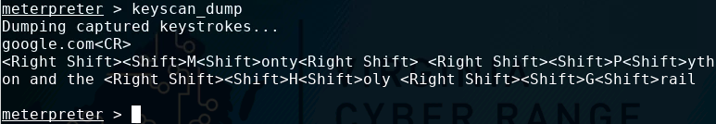
Viewing the Logged Keys
Go to the Kali Environment
Display all the keys logged:
keyscan_dump
What keys were logged?

Slide 13
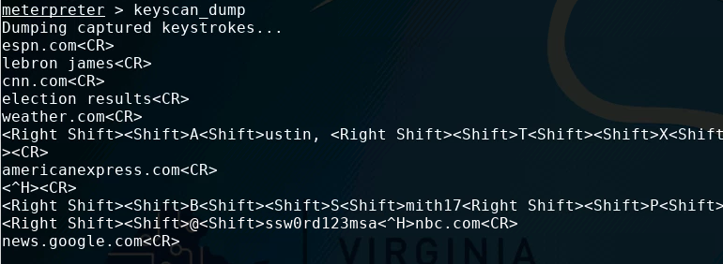
Deciphering Keys Logged
What private information can be gathered from the following keyscan?

Slide 14
Your Turn
Migrate to Google Chrome
Google Chrome must be open to have and display a PID
Start keylogging for Chrome
Visit some websites on Google Chrome
See the keylogger results for Chrome
What information could be harvested if you were to run a keylogger on the process winlogon.exe?

Slide 15
How to Defend Against a Keylogger?
Avoid re-using passwords across multiple websites
If one site steals your password once and they're all the same...
Use a firewall!
Remember you disabled the firewall at the beginning of this lab
Firewalls help prevent malicious software from sending out data without you knowing
Two-Factor Authentication
Why would these help secure your password?
What are some other ways of defending against a keylogger attack?

